Slide 1

Operation Analytics and Investigating Spike
Metric
Noorul Ain Fatima

Slide 2
About This Project
Tech stack used-
MySQL workbench
Goal-investigating metric spikes
Approach- we aim at gaining some useful information from the raw data using MySQL.

Slide 3
About this Project
In this project we have to observe the operational metrics and find the pattern of operations to figure out any irregularities and the reason behind it to help the management in their decision making and improving company’s performance

Slide 4
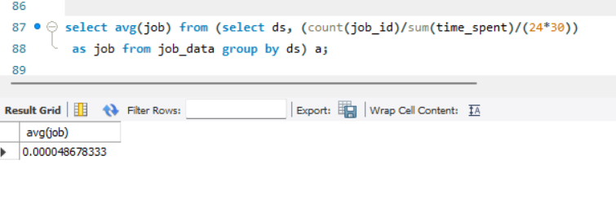
1. Average task reviewed per hour
Objective: Calculate the number of jobs reviewed per hour for each day in November 2020.
To find it we find total jobs in nov month and divide it with the 30 days of month and again divide it with 24 hours of the day.

Slide 5
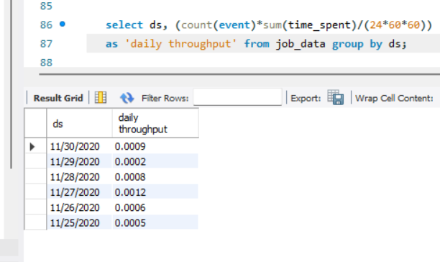
2. Throughput Analysis:
Objective: Calculate the 7-day rolling average of throughput (number of events per second).
To find it we calculate total no. of jobs and multiply it with time spent in doing the job and divide it with 24,60,60 for hours, minute and seconds of the day respectively.
I find this rolling avg method more useful in getting insight as it is more detailed and concise.

Slide 6
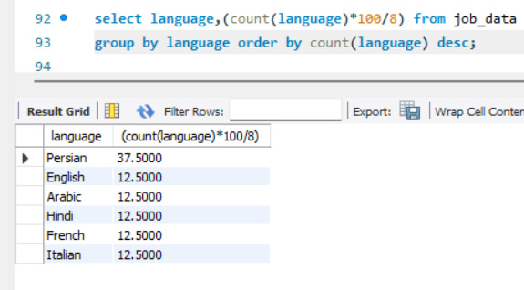
3. Language Share Analysis:
Objective: Calculate the percentage share of each language in the last 30 days.
To find it we divide the language by total no. of languages and multiply it by 100.

Slide 7
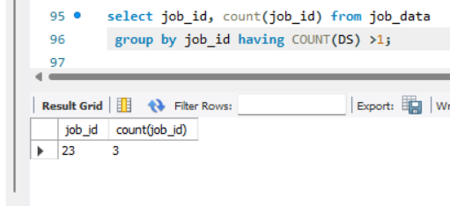
4. Duplicate Rows Detection:
1. select job_id, count(job_id) from job_data group by job_id having COUNT(DS) >1;
2. select actor_id, count(actor_id) from job_data group by actor_id having COUNT(DS) >1;
3. select event, count(event) from job_data group by eventhaving COUNT(DS) >1;
4. select language, count(language) from job_data group by language having COUNT(DS) >1;
5. select org, count(org) from job_data group by org having COUNT(DS) >1;
6. select ds, count(ds) from job_data group by ds having COUNT(DS) > 1;

Slide 8
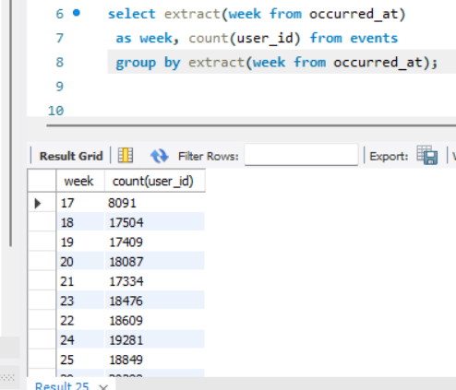
Case Study 2: Investigating Metric Spike 1. Weekly User Engagement
Objective: Measure the activeness of users on a weekly basis.
To calculate it we use extract function to group data in weeks and count user ids active per week
HIGHLIGHT- min active users are 802 in week 35. Max active users are 21771 in week 30.

Slide 9
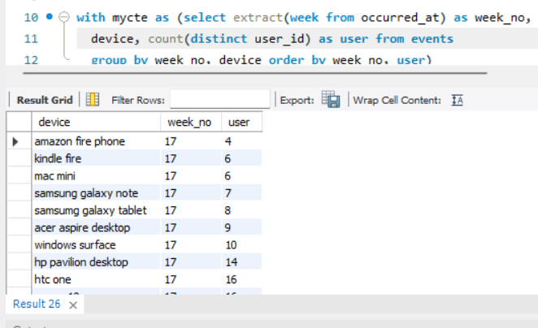
2. User Growth Analysis:
Objective: Analyze the growth of users over time for a product.
To calculate it we are using common table expression function and extract function group data by week, we are using distinct count function to count unique ids.
HIGHLIGHT- min users (1) in week 35 for a device is acer aspire desktop. Max users (322) in week 30 for a device is Macbook Pro.
In week 35 there is a drastic drop in count of users.

Slide 10
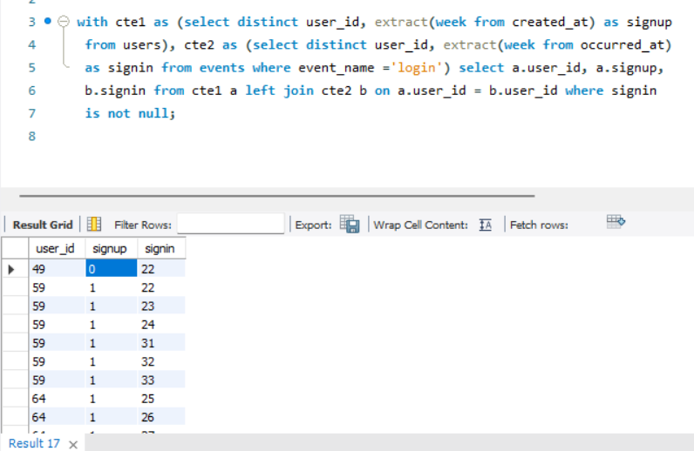
3. Weekly Retention Analysis:
Objective: Analyze the retention of users on a weekly basis after signing up for a product.
Observation- At first I write thus syntax without not null clause so result(25254) came with null values in signin column. After adding not null clause result showed retained users(22015).

Slide 11
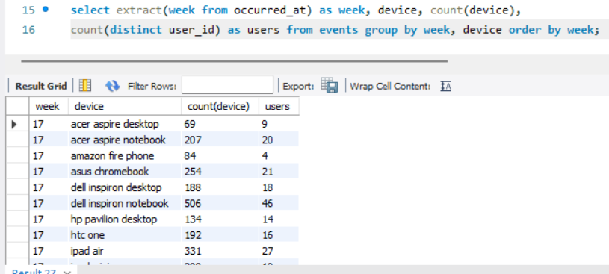
4. Weekly Engagement Per Device:
Objective: Measure the activeness of users on a weekly basis per device.
HIGHLIGHT- 321 users have used MacBook pro 3649 times in week 31
Most used device in all top 12 weeks are all MacBook pro.

Slide 12
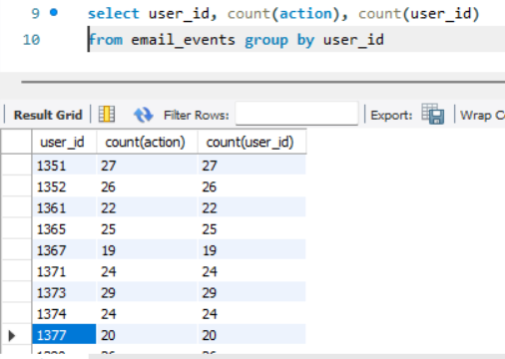
5. Email Engagement Analysis:
Objective: Analyze how users are engaging with the email service.
To find it we have count all the actions performed by a user in their email services like email open, sent weekly digest.
User ID 6612, 3390 have performed most actions in their email service (37 actions)

Slide 13
RESULT
Form the weekly user engagement we found, most users are active in weeks between 27 to 30.
In week 35 there is a drastic drop in count of users per device.
In all the top 12 most engaged weeks, the devices which were used was MacBook pro.
Least used devices are Amazon Fire Phone and Samsung galaxy tablet on avg of every week.
Avg actions performed by users in their email services are 14.628.

Slide 14
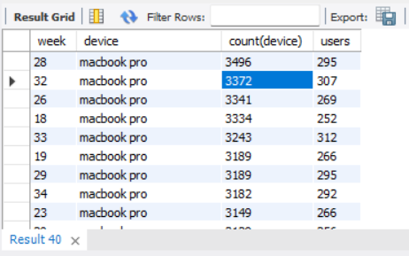
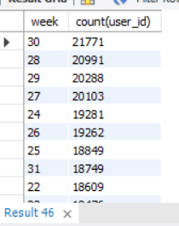
Snaps of the observation
Most used devices in top 12 week
Weeks in which users are most active

